Slide 1
Predicting Sleep Quality from Multimodal Wearable and Survey Data: Analysis of MMASH Dataset
Mihir Kalyanthaya
DataSci223

Slide 2
MMASH Dataset
Multilevel Monitoring of Activity and Sleep in Health people
this dataset contains 24 hours of continuous beat-to-beat heart data, triaxial accelerometer data, sleep quality, physical activity and psychological characteristics (i.e., anxiety status, stress events and emotions)
22 healthy participants
saliva bio-markers (cortisol and melatonin) and activity log were also included
enable researchers to test the relationships between physical activity, sleep quality, and psychological characteristics
the data were collected and provided by BioBeats (produces IoT wearable devices aiming to detect people's psychophysiological stress) in collaboration with researchers from the University of Pisa

Slide 3
Data Collected
anthropomorphic characteristics (age, height and weight) of the participants were recorded
participants filled in a set of initial questionnaires that provide information about participants psychological status
Morningness-Eveningness Questionnaire (MEQ)
State-Trait Anxiety Inventory (STAI-Y)
Pittsburgh Sleep Quality Questionnaire Index (PSQI)
Behavioral avoidance/inhibition survey (BIS/BAS)
participants wore two devices continuously for 24 hours:
heart rate monitor (Polar H7 heart rate monitor, record heartbeats and beat-to-beat interval)
actigraph (ActiGraph wGT3X-BT, record actigraphy information such as accelerometer data, sleep quality and physical activity)
perceived mood (Positive and Negative Affect Schedule - PANAS) were recorded at different times of the day
participants filled in Daily Stress Inventory (DSI) before going to sleep, to summarize the stressful events of the day
sleep efficiency (latency efficiency) defined as the percentage of sleep time on total sleep in bed

Slide 4
Statistical Methods
research question of interest: what are the associations/relationships between sleep quality (efficiency) and the various predictors (heart rate, number of awakenings, screen time, total sleep time)
to assess this, I used:
multiple linear regression to interpret predictors of sleep quality
regularized regression (ridge, lasso) to control for multicollinearity and select important features; shrink coefficients
random forest regression to capture nonlinear effects and is robust to outliers; models complex interactions
cross validation performed subject-wise to prevent data leakage
the sample size is small/homogeneous, so I used regularization and cross-validation
the researchers did not collect/record the exact time of the first awakening or a time-to-event variable only summary measures (total number and duration of awakenings, WASO, etc.)
exposure: total sleep time, # of awakenings, screen time, heart rate, physiological/behavioral measures
outcome: sleep efficiency

Slide 5
Statistical Analysis Results
number of awakenings emerged as the strongest statistically significant predictor of sleep efficiency (β = -0.421, p = 0.003)
each additional awakening associated with a 0.42 percentage point decrease in sleep efficiency
screen time exhibited a modest positive association with sleep efficiency (β = 0.020, p = 0.427) across all models, although this relationship did not reach statistical significance
confounding analysis indicated that total sleep time substantially confounded the relationship between screen time and sleep efficiency, with the screen time coefficient decreasing by 17% when adjusting for sleep duration
fully adjusted model had explanatory power (R² = 0.411, Adj. R² = 0.313); number of awakenings remaining the only statistically significant predictor
bootstrap stability analysis confirmed that while coefficient estimates showed considerable variability, the model's overall explanatory power was robust (82.9%)
model evaluation revealed limitations in predictive capability, with poor cross-validation performance (R² = -2.69) indicating overfitting—an expected outcome with small samples
linear regression without interaction terms provided the most reliable predictions, suggesting the underlying relationships may be fundamentally linear despite the limited sample size

Slide 6
Statistical Analysis Results
Assumption checks for linear regression:
Normality of residuals: the Omnibus (p = 0.55) and Jarque-Bera (p = 0.58) tests indicated no significant deviation from normality
Linearity and homoscedasticity: residuals vs. fitted values plots did not reveal any obvious non-linearity or heteroscedasticity
Independence: the Durbin-Watson statistic was 2.70, showing no evidence of residual autocorrelation
Multicollinearity: largest Variance Inflation Factor among predictors was 5.6, suggesting moderate but not problematic multicollinearity
Bootstrap Analysis
stable features:
screen time and awakenings x screen time selected in 100% of bootstrap samples
screen time consistently shows a positive coefficient (CI: 0.050-0.212)
small negative effect
less-stable features:
total sleep time selected in 83% of samples but has coefficient near 0
# of awakenings selected in 56% of samples
CI Analysis
screen time effect is positive (CI does not cross zero)
interaction term effect is negative (CI does not cross zero)
total sleep time effect uncertain (CI crosses zero)

Slide 7
Statistical Analysis Results
5-fold cross-validation
cross-validated r-squared scores: [-1.43, 0.15, -12.66, 0.01, 0.47] the model performed worse than simply predicting the mean of target variable (due to small sample size)
mean r-squared across folds (-2.69) the model has poor predictive power and generalizes poorly to new data
standard deviation = 5.03 high variability between folds and influential data points
caused by small sample size, heterogeneity in sleep patterns, overfitting
the results should be interpreted with caution; more data and predictors are needed for a more robust model performance
residual histogram
the residuals are approximately normally distributed which supports normality assumption of linear regression
no extreme outliers
variance inflation factors
All the VIF values are less than 10, therefore no severe multicollinearity
sleep_total_sleep_time and sleep_number_awakenings are moderately correlated (VIF 5.64 & 4.17 respectively)

Slide 8
Statistical Analysis Results
logistic regression analysis for predicting binary sleep efficiency (cutoff @ 85% efficiency):
Pseudo r-squared: 0.2043 this model explains ~20% of variance in log-odds of outcome
LLR p = 0.10 not statistically significant
for each additional awakening, log-odds of “good sleep” decreased by 0.135 (holding other variables constant)
# of awakenings shows strongest borderline association (p=0.064) with good sleep efficiency
total sleep time and screen time were not significant predictors
low statistical power due to small sample size (interpret these results with caution)
Biases
selection bias – sample is not representative of the general population
measurement bias – measurement devices may inaccurately record sleep/awake times
Recall bias – subjective measures and behaviors may be inaccurately recorded by participants
Confounders
age, mental/physical health and socioeconomic status are all variables that if not controlled for could confound the relationship between the predictors and sleep efficiency
reverse causality: some exposures (ex. screen time) may be affected by poor sleep rather than causing it
there are many unmeasured variables that the authors did not include/measure that may be associated with exposure and outcome (caffeine use, work schedule) which would add bias

Slide 9
Model Comparisons
Model | AIC | BIC | CV R² | CV Accuracy | CV AUC | Interpretation
Linear OLS | 141.75 | 146.12 | -2.69 | – | – | Very poor fit
Ridge Regression | – | – | -2.69 | – | – | No improvement
Lasso Regression | – | – | -2.68 | – | – | No improvement
Logistic Regression | 32.27 | 36.63 | – | 0.58 | 0.60 | Barely better than random
Logistic Ridge (L2) | – | – | – | – | 0.60 | No improvement
Logistic Lasso (L1) | – | – | – | – | 0.60 | No improvement
none of the models show strong predictive power
regularization does not improve performance
logistic model performs slightly better than chance but not strong classifier
linear models perform poorly

Slide 10
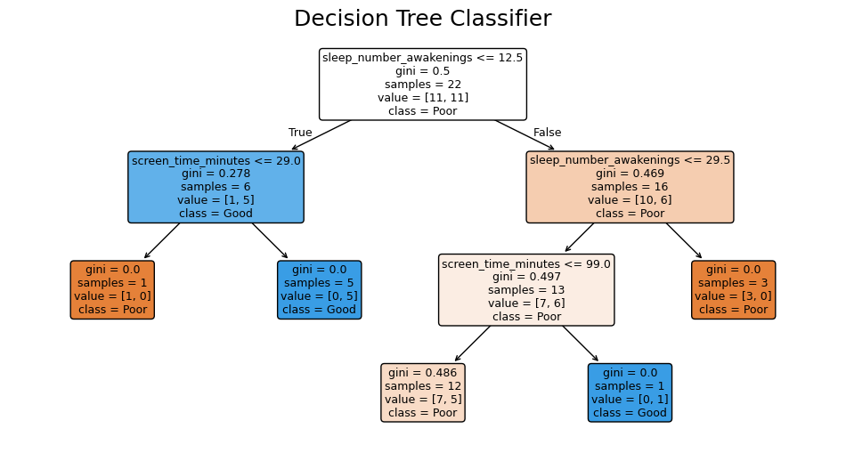
Decision Tree Classifier
tree primarily uses the number of awakenings and screen time to split the data
decision tree classifier achieved an average cross-validated accuracy of 0.47, which is below the 0.5 threshold for random guessing in a balanced binary classification problem
relatively high standard deviation (0.18) suggests considerable variability in performance across the folds, likely reflecting the small sample size and sensitivity to data splits
“Good" sleep efficiency is mostly found in participants with ≤12.5 awakenings and low screen time
Most other splits assign "Poor" sleep efficiency, especially with higher awakenings and/or higher screen time

Slide 11
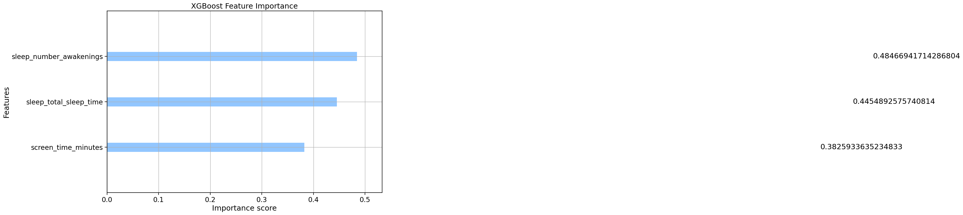
XGBoost
Cross-validated Accuracy: 0.55 (std: 0.20)
Cross-validated AUC: 0.48 (std: 0.08)
sleep_number_awakenings (Importance: 0.48)
sleep_total_sleep_time (Importance: 0.45)
screen_time_minutes (Importance: 0.38)
model is not able to discriminate between “good” and “poor” sleep efficiency better than random chance
XGBoost identifies number of awakenings and total sleep time as the most important predictors for classifying sleep efficiency status, with screen time playing a somewhat smaller but still notable role
given the low predictive power (AUC < 0.5), even the most “important” variables do not yield effective discrimination in this dataset

Slide 12
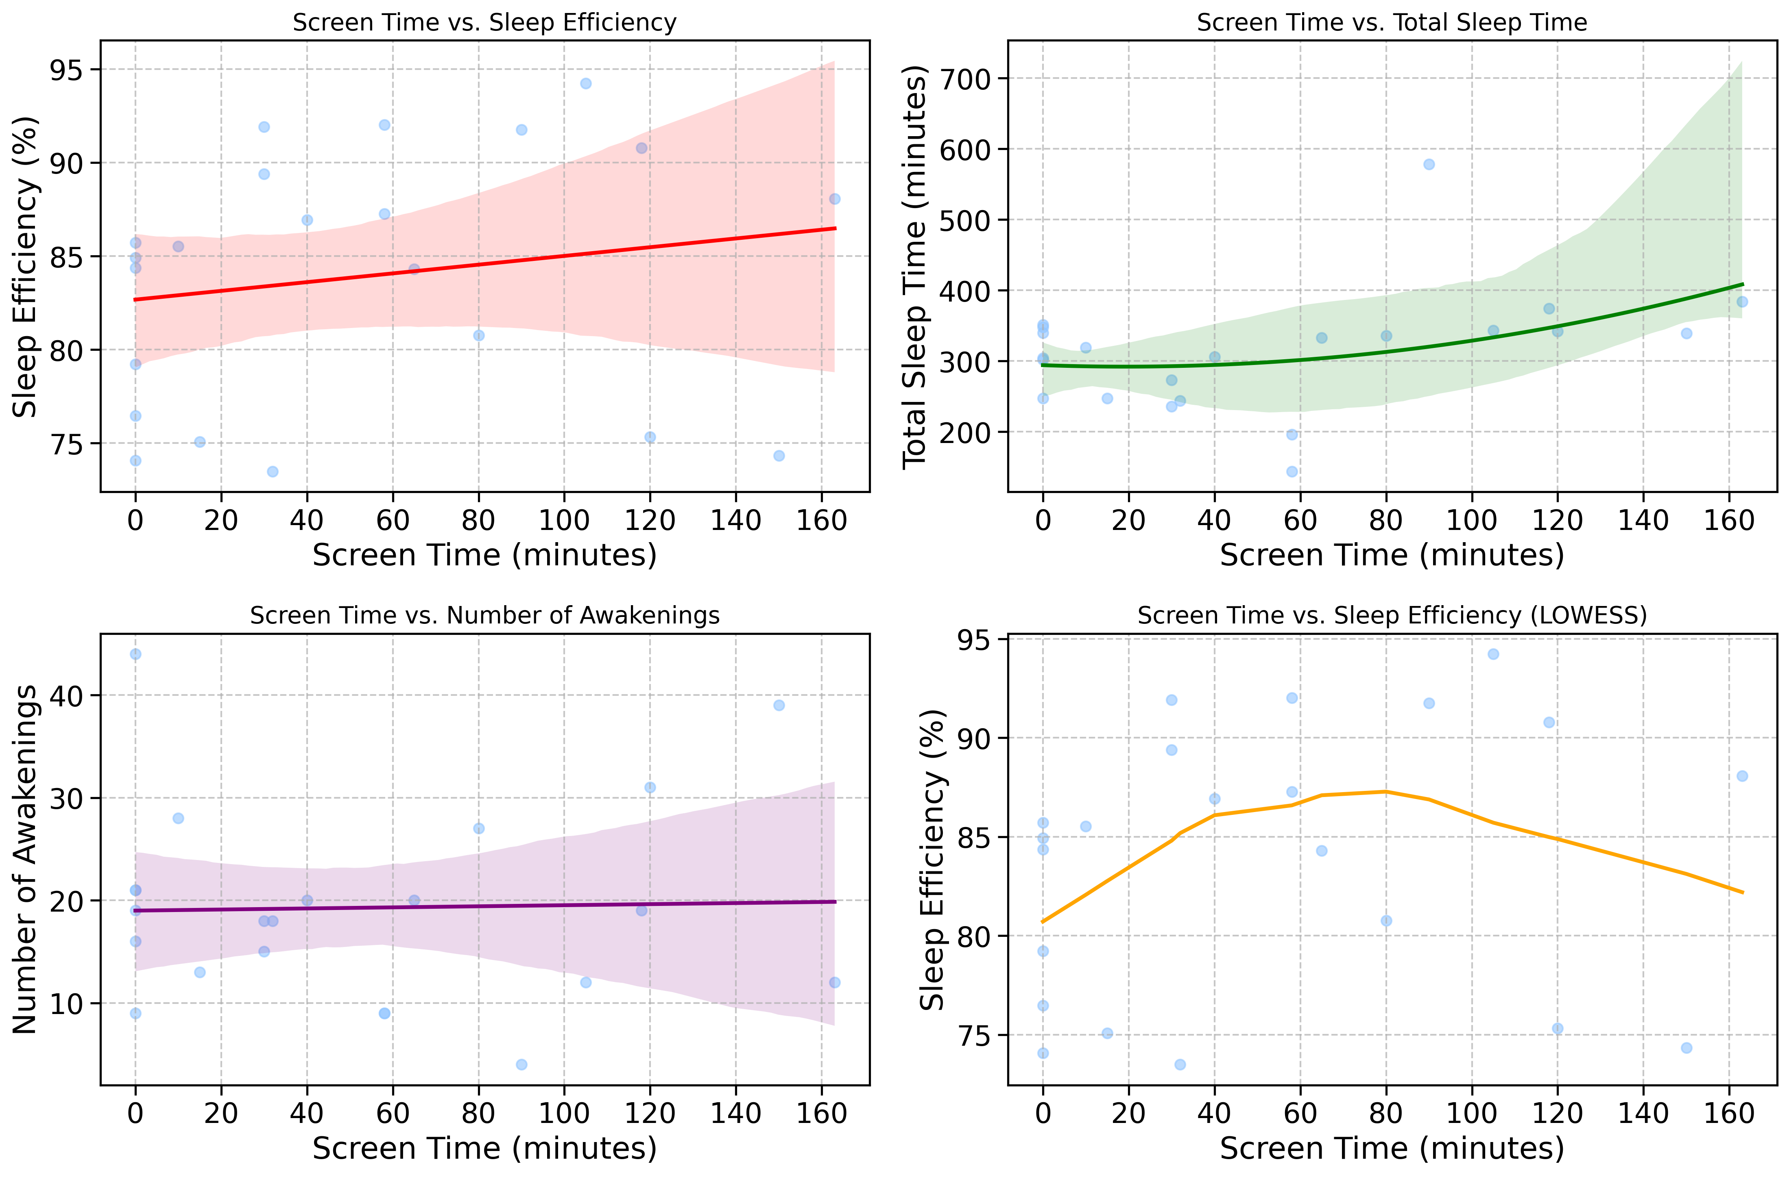
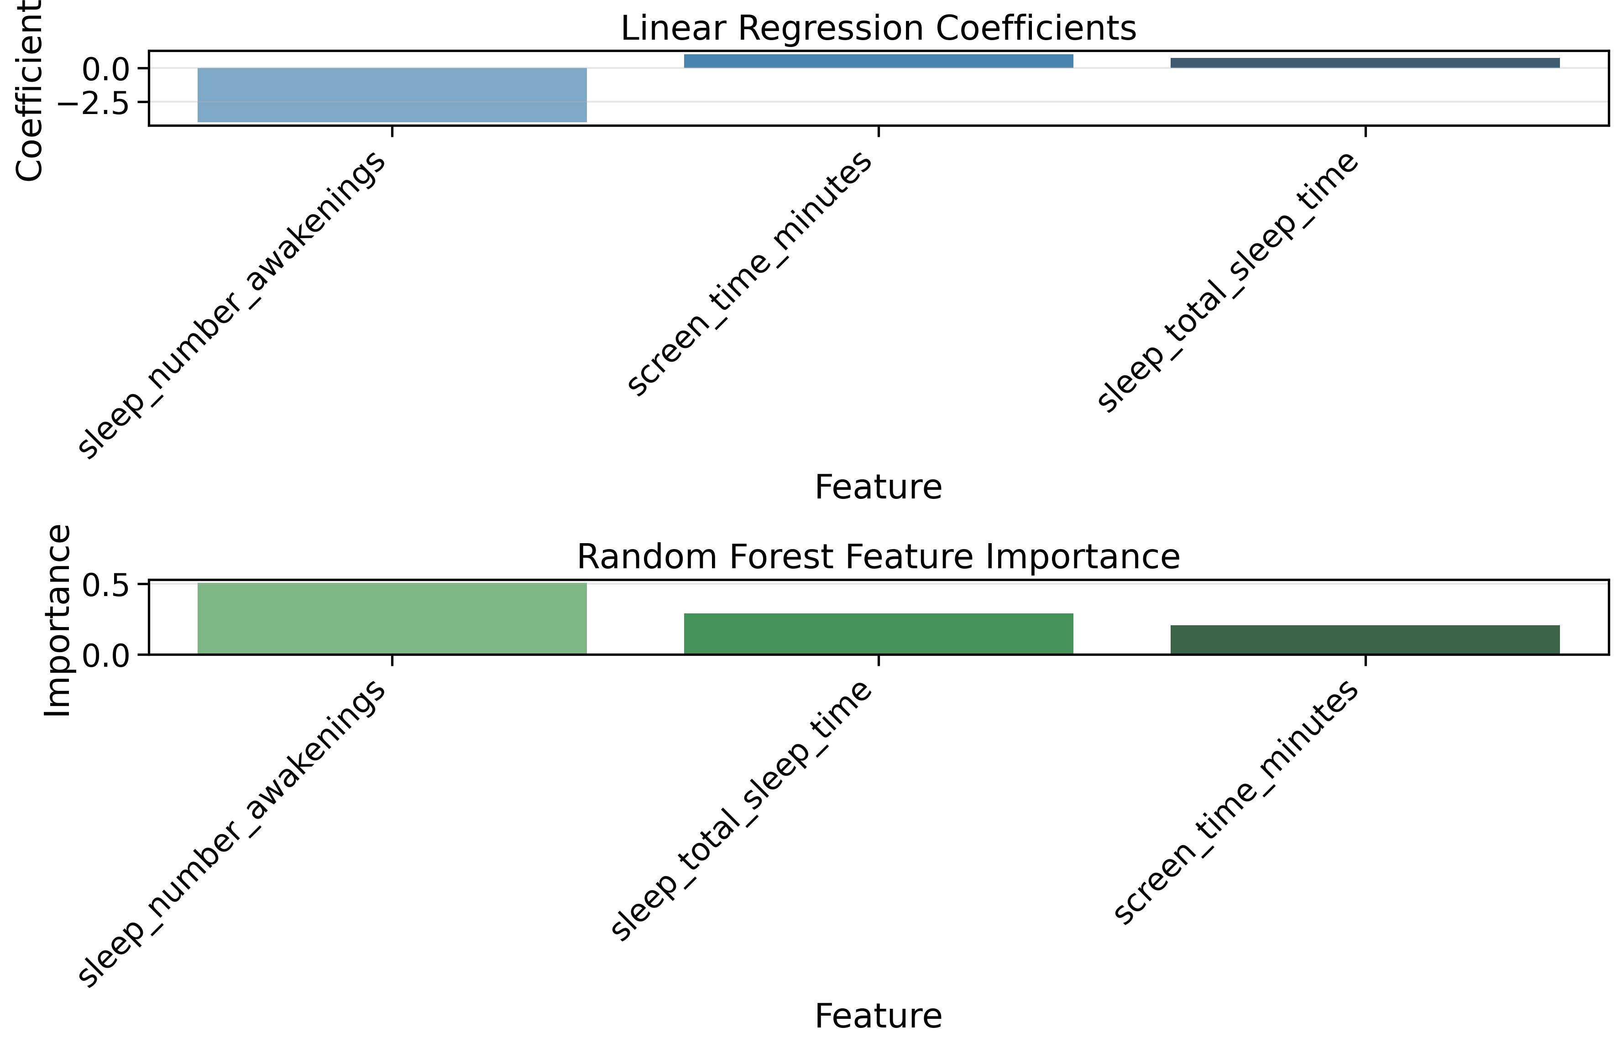
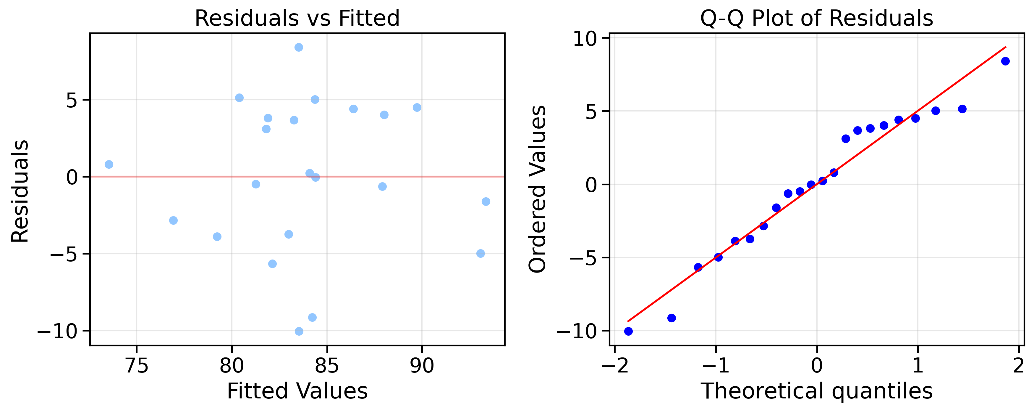

Slide 13
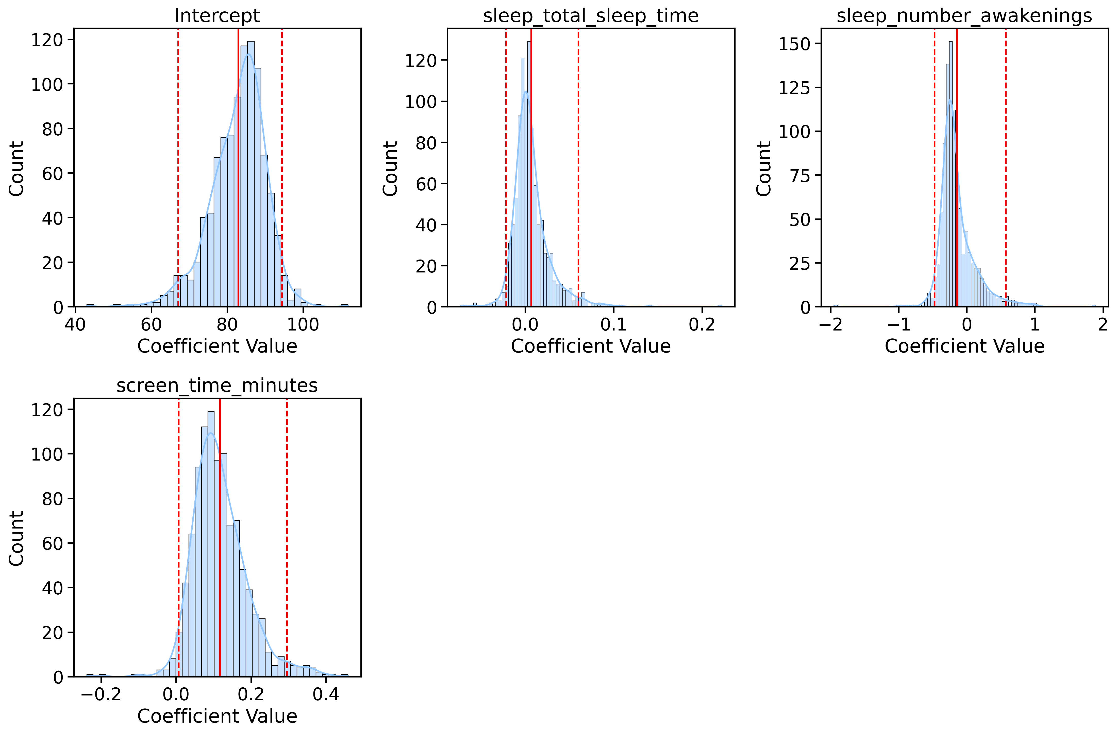
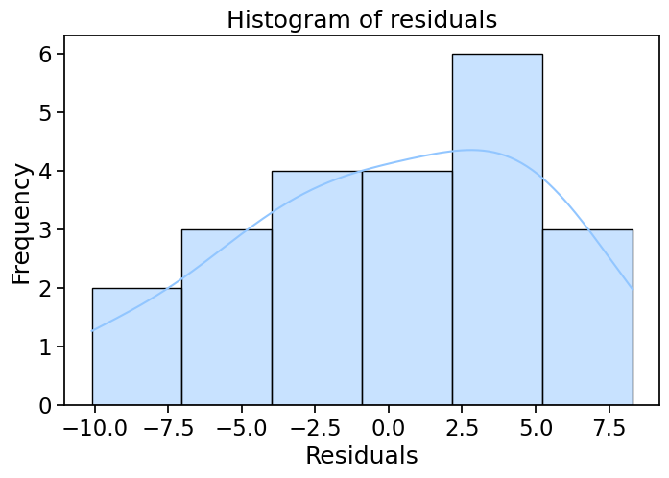
 | Variable | Description | Mean (SD) | Median [IQR] | Min–Max | n (missing)
0 | Efficiency | Sleep efficiency (%) | 83.91 (6.75) | 85.22 [77.16–89.06] | 73.49–94.23 | 22 (0)
1 | Total Sleep Time | Total sleep time (min) | 313.00 (84.31) | 326.00 [253.50–342.75] | 144.00–578.00 | 22 (0)
2 | Number of Awakenings | Number of awakenings per night | 19.27 (9.78) | 18.50 [12.25–21.00] | 4.00–44.00 | 22 (0)
3 | Screen Time (min) | Screen time before bed (min) | 52.91 (52.11) | 36.00 [2.50–87.50] | 0.00–163.00 | 22 (0)
Bootstrap distributions
Table 1. Descriptive statistics of key study variables (n=22)

Slide 14
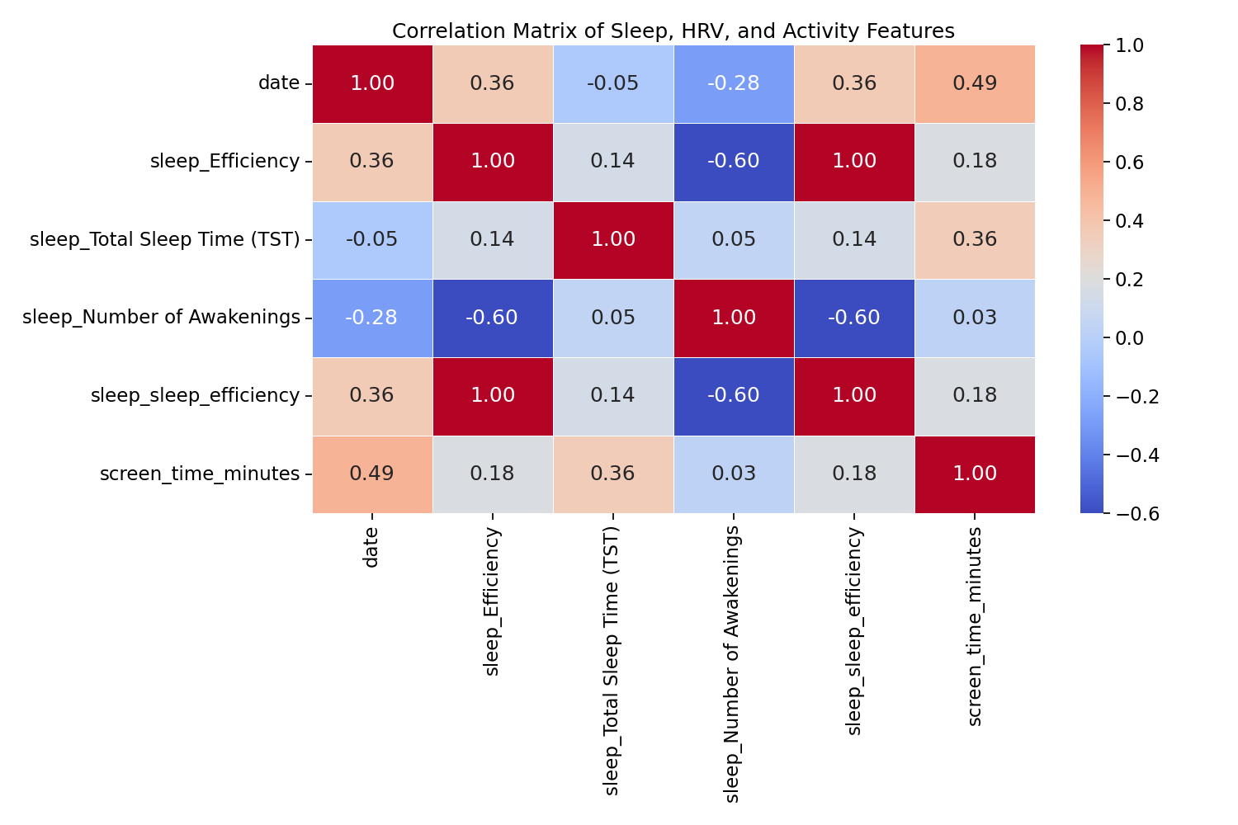
Correlation Matrix
Screen time shows a weak positive correlation with sleep efficiency (0.18) - this suggests that screen time didn't negatively affect sleep efficiency in this small dataset (not statistically significant)
Number of awakenings has a strong negative correlation with sleep efficiency (-0.60) - this makes intuitive sense: more awakenings lead to poorer sleep efficiency
Screen time correlates moderately with date (0.49) - This suggests that screen time usage patterns changed over the days of the study

Slide 15
Key Takeaways
MMASH data provides better modeling due to its novelty for further exploratory sleep analysis
the researchers did not record the exact time of the first awakening or a time-to-event variable preventing survival analysis methods (KM or Cox regression)
the authors note that, to date, this is the only publicly available resource providing a comprehensive, multimodal record of healthy individuals’ physiological, psychological, behavioral, and biomarker data over a 24-hour period
previous studies on this topic have been limited to single data streams, whereas this data leverages the integration of objective physiological signals, self-reported psychological measures, and detailed behavioral logs
this and future research demonstrates the feasibility of predicting perceived sleep quality (PSQI) from a blend of real-world, passively, and actively collected features
this can lead to clinically meaningful predictive modeling
keep in mind the data is homogenous/small sample size which limits the generalizability of the findings
Future studies should collect detailed event-level data (time to first awakening) to enable such analyses and aim to replicate these findings in more diverse and larger cohorts

Slide 16
Citations
Rossi, A., Da Pozzo, E., Menicagli, D., Tremolanti, C., Priami, C., Sirbu, A., Clifton, D., Martini, C., & Morelli, D. (2020). Multilevel Monitoring of Activity and Sleep in Healthy People (version 1.0.0). PhysioNet. https://doi.org/10.13026/cerq-fc86.
Original publication: Rossi, A., Da Pozzo, E., Menicagli, D., Tremolanti, C., Priami, C., Sirbu, A., Clifton, D., Martini, C., & Morelli, D. (2020). A Public Dataset of 24-h Multi-Levels Psycho-Physiological Responses in Young Healthy Adults. Data, 5(4), 91. https://doi.org/10.3390/data5040091.
Goldberger, A., Amaral, L., Glass, L., Hausdorff, J., Ivanov, P. C., Mark, R., ... & Stanley, H. E. (2000). PhysioBank, PhysioToolkit, and PhysioNet: Components of a new research resource for complex physiologic signals. Circulation [Online]. 101 (23), pp. e215–e220.

